Slide 1

Strategic Analytics Candidate Challenge
Yash nakadi

Slide 2
Analysis of Perpay Loan Acquisition Funnel
Introduction and Overview of Data
Insights and Concerns for the Funnel
Recommendations and Next Steps

Slide 3
Introduction
Perpay’s Loan Application Funnel is as follows:
User checks out item(s) on the Perpay Marketplace and starts a loan application
User provides relevant information and completes the application
Application is approved or denied
If approved, user sets up direct deposit and number of payments
Once first payment has been made, loan enters repayment

Slide 4
Data Overview
User dataset
Loan dataset
95755 unique users
All users signed up between October 13 and November 6, 2020 (did not necessarily apply for a loan during this time)
First loan application date ranges from 2016 to 2023
39012 unique loans, 31631 unique users
All applications were between October 13 and November 6, 2020, different from user dataset which had the same time frame for the sign up date

Slide 5
Data Overview Cont.
Approvals
cancellations
From loans data frame, vast majority of approvals were ftb (first time buyer) decision, done automatically
Majority of cancellations came from no payment arriving after roughly 4 months (automated)
Risk tier
Spending limit
All users in loan data table had a risk tier of TØ, meaning they are first time buyers who have not yet fully repaid their loan
Most users with an approved loan started with a spending limit of $1000 (upper limit)

Slide 6
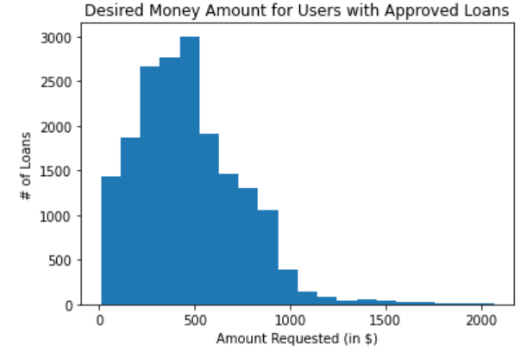
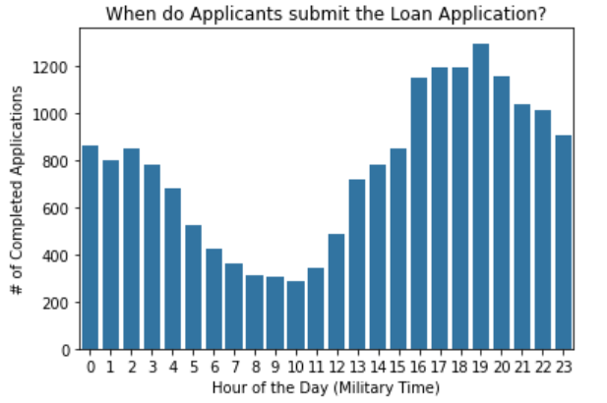
Data Overview Cont.
Number of payments
Amount requested
Majority of users wanted to repay over 8 payments, followed by 16, then 4, then 2
When users are active
If data is Greenwich time, most active around the afternoon
Majority of approved loans were priced around $500; very few exceeded $1000

Slide 7
Peculiarities in Data?
Users data
Loans data
Some users without a valid phone number could complete an application and enter repayment
Of the 95575 users, only 25105 started their first application
3.5% of users were referred
1314 instances where an application was registered as completed in user data table but NOT registered as complete in loans data table
Discrepancy between timestamps for cancellation and timestamps for awaiting payment and repayment
Several users with approved loans had a higher loan amount than (estimated) spending limit

Slide 8
Loan Acquisition Funnel
Built using the loan data frame
Representative sample of loans, with application start times between October 13 and November 6, 2020
Loan data frame has features that allow for further analysis:
Approval Type & Timestamp
Cancellation Type & Timestamp
Pinwheel Eligibility

Slide 9
Funnel Metrics
Measures of engagement:
Loan Application Completion Rate (LACR)
Direct Deposit Rate (DDR)
Percent of Loans to Enter Repayment (RR), and how long that takes
Company-specific metrics:
Approval Rate
Time to Approval (TTA)
Time to Set Up Direct Deposit

Slide 10
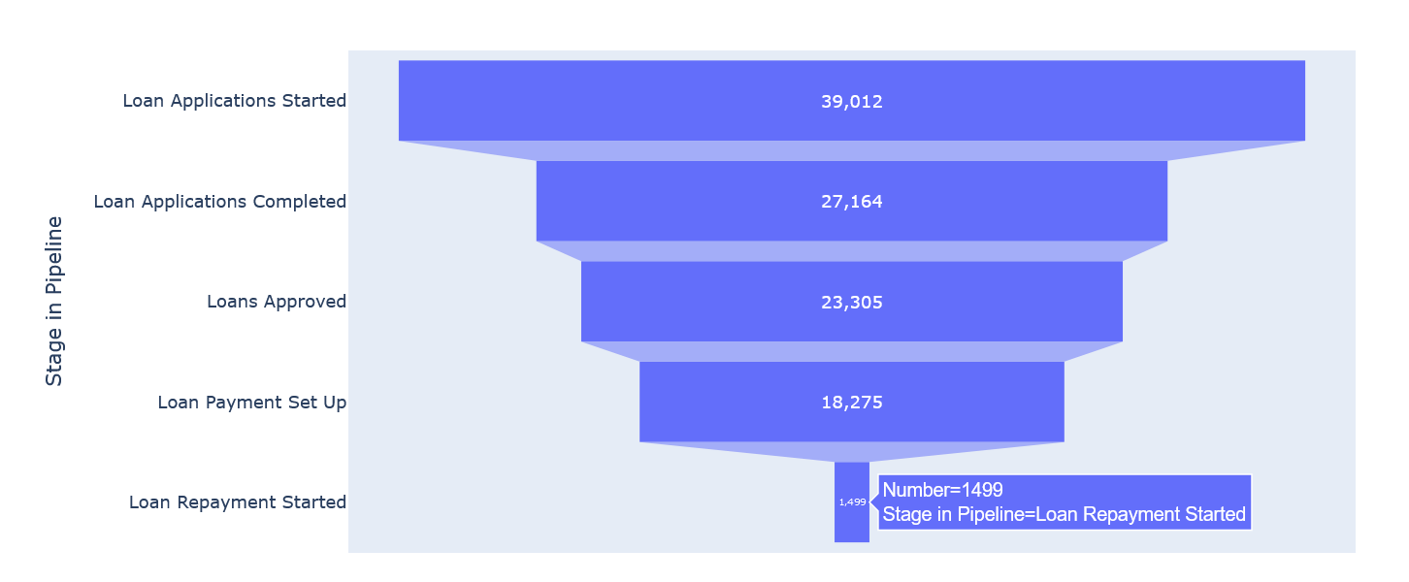
Loan Application Funnel

Slide 11
Metrics
Measures of engagement (from loan dataset):
LACR → 69.6% of applications are completed
DDR → 78.4% of approved applications are set up for Direct Deposit
RR → 8.2% of loans set up for Direct Deposit enter repayment
69.2% of such loans (1037 total) enter repayment within the first 15 days
Company-specific metrics:
Approval Rate → 85.8% of completed applications are approved

Slide 12
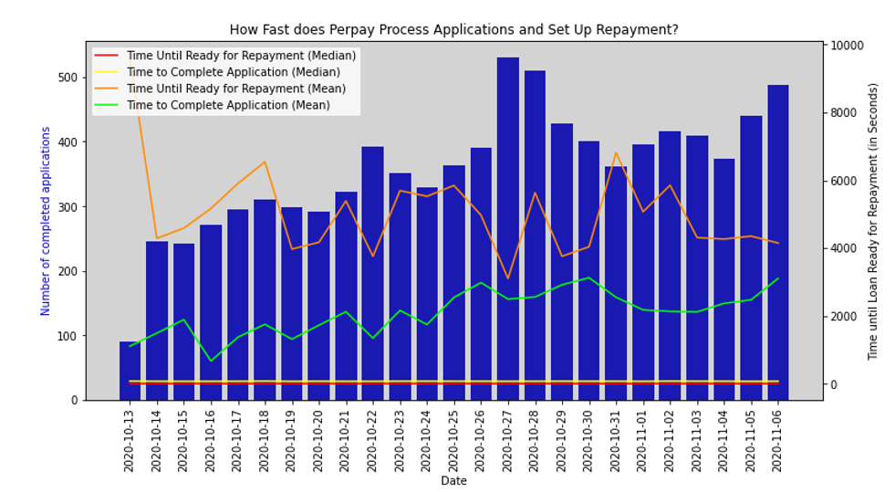
Time to Approval, Time to Set Up Repayment
Observations
Median TTA and median time to set up direct deposit is extremely quick (1-2 seconds)
Response times are not affected by volume of completed applications

Slide 13
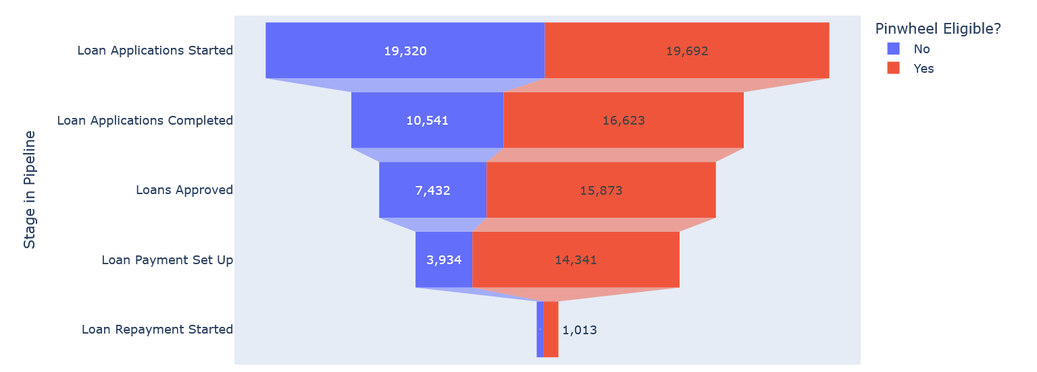
Pinwheel
Pinwheel allows users to set up payments without having to manually log into their payroll provider website
Pinwheel eligible users are far more likely to be set up for repayment

Slide 14
Overall Insights
Concerns
Interesting observations
Very low repayment rate, despite apparent interest in the loan until the final stage
Perpay’s response times are very quick and improvement there is limited
All users were TØ risk tier, a population that is more likely to have a lower repayment rate
Besides awaiting payment, most loan applications are cancelled for deposit failure, automated pending, and remorse
Users who were Pinwheel eligible did much better across all metrics except RR

Slide 15
Recommendations and Next Steps
address technical issues
Improve Engagement
Resolve discrepancies in the user and loan datasets, such as:
“Deny” is an approval type for both manual and automatic approvals
Whether or not users without a valid phone number can complete an application (and even have it approved and set up for repayment)
Inconsistencies in the timestamp data between the two datasets
Services like Pinwheel greatly increase engagement, likely due to improvement of user experience
Push more reminders to the user to send the first payment
Perhaps offer incentives or more incentives to boost referrals

Slide 16
Recommendations and Next Steps Cont.
Diversify data
experimentation
All loans have risk tier TØ, explore other risk types
Add other features, related to the eligibility requirements (for instance, being in good financial standing)
Explore the categories of products being bought (electronics, tools, food, etc.)
Offer more discounts, rewards on Marketplace to see how that affects loan behavior
A/B Testing with the Marketplace webpage
Perhaps offer incentives or more incentives to boost referrals

Slide 17
Questions?

